Slide 1
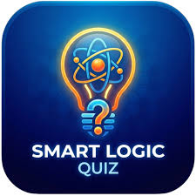
🧠QUIZCRAFT
Smart Quiz Generator
Time Saving & Automated
User Friendly Interface
Instant Result & History
TEAM MEMBERS :
Vanshika
Tamanna
Vanshika

Slide 2

The Problem – What does our app solve?
Too much study
material
(long PDFS)
Overwhelming notes &
resources are hard to review
No quick way to
test understanding
Students can’t self assess
knowledge easily
Manual quiz making
is boring
Time consuming and repetitive
to create quizzes
No instant feedback
Learners wait too long to
know if they’re right or wrong
Solution: Quiz Craft ->
Turns any PDF / Text notes into instant MCQ quiz

Slide 3
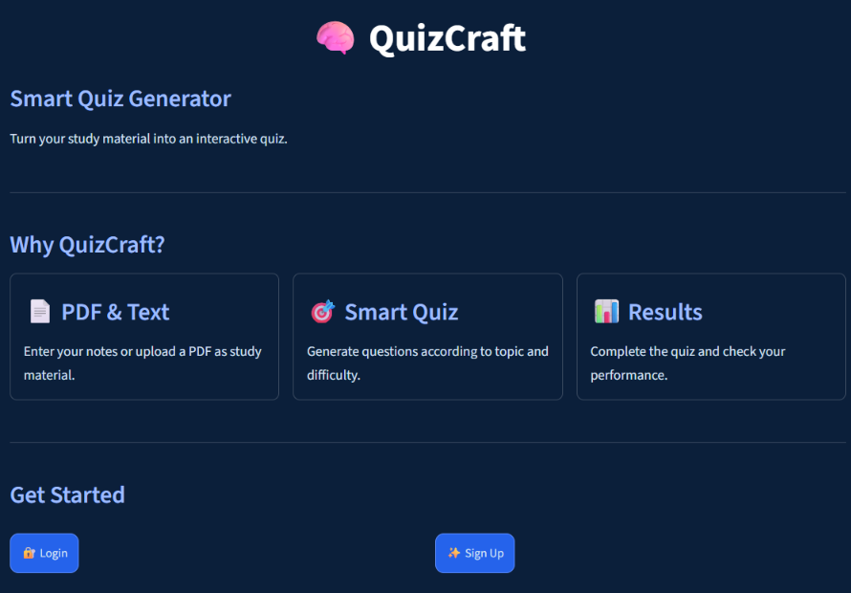
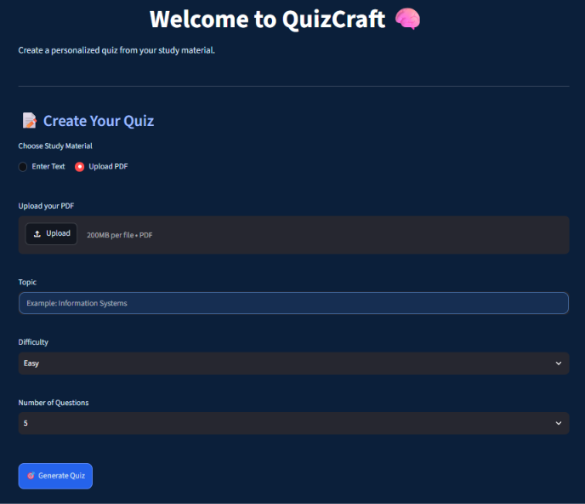
Our Solution
QuizCraft automatically coverts any PDF or notes into an interactive
MCQ quiz with instant results

Slide 4





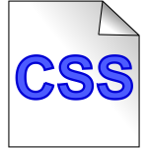
Technology Stack-QuizCraft
Core technologies powering the application
Python
Streamlit
SQLite(quizcraft.db)
Backend Language,
Core logic & Data processing
Web app Framework,
Interactive UI & Dashboard
Lightweight Database, Stores
quizzes & user data
PyPDF
Regex NLP Pattern
Matching
Custom CSS
Extract Text from Uploads
Custom styling &
Responsive clean UI design
Text Pattern Analysis &
NLP Processing

Slide 5



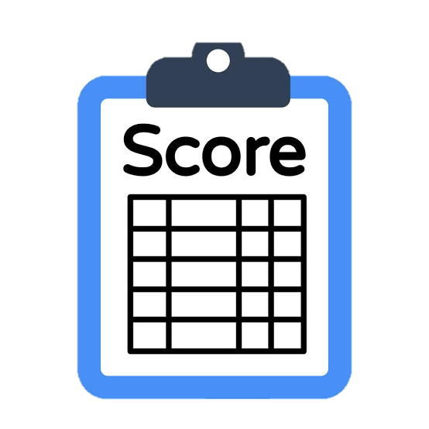



QuizCraft - System Architechture
End-to-End Quiz generation & Evaluation Flow
7-step process
User Input
Text Extraction
Concept Extraction
Quiz generation
Streamlit UI
Evaluation &
Result
Database
storage
Text or PDF
PyPDF ,
Extract_text_from
_PDF +
Clean_text
Regex pattern
matching
Generate_quiz
Quiz Attempt
Score & percentage
SQLite
User Provide
Content Via
Text Entry or
PDF Upload
Extract Raw Text
from uploaded
PDF ,Clean &
Pre-process text
Pattern: “is a”
Pattern: “is used for”
Pattern: ”Provides”
Create Multiple-
choice question
Interactive UI for
users to attempt quiz
Calculate score
&
Compute percentage
Quiz history

Slide 6
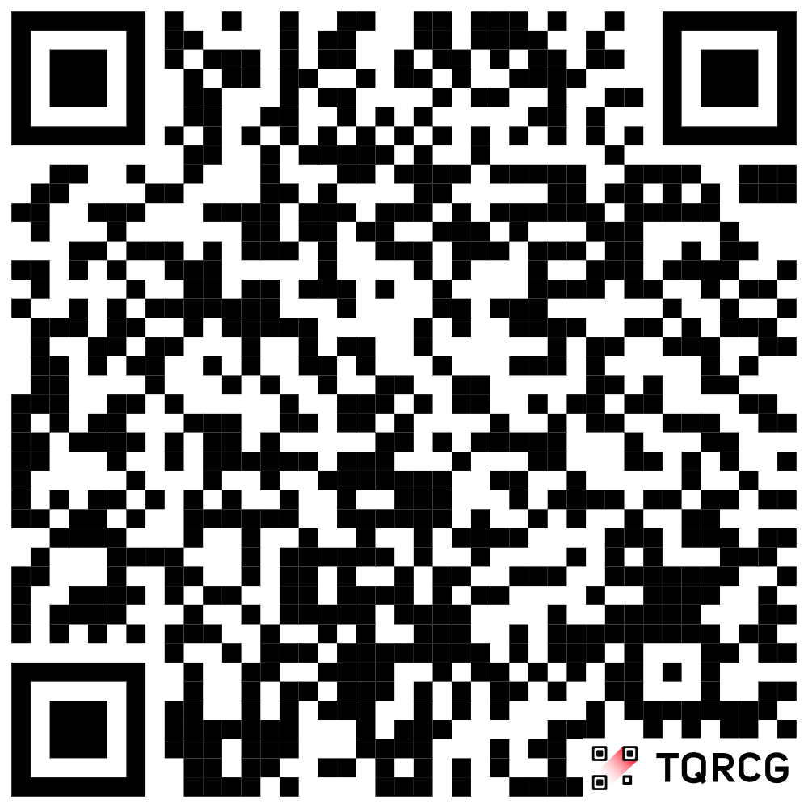
Live Demo & Deployed Link
https://quizcraft-ht5u2jowmcr32d594db23a.streamlit.app/
Scan the QR code or Click the Link above for the access of live deployed application

Slide 7
Challenges Faced
PDF Extraction
Question Generation
Instant Evaluation
Different PDFs can have different layouts.
PyPDF is used to extract the text before cleaning and preprocessing.
The extracted text has to be converted into meaningful MCQs.
Regex pattern matching helps identify useful patterns.
The quiz must calculate the score and percentage immediately after an attempt.
Database Handling
Clean Interface
Quiz information and history are stored in SQLite for later access.
The Streamlit UI needs to stay simple and easy to use while supporting the complete flow.
7/11

Slide 8
Our Role in the Project
Project Planning
Implementation Flow
Demo & Presentation
• Identified the problem
• Defined the solution flow
• Organized the presentation structure
• Connected the features to the user need
• PDF / text input
• Text extraction & cleaning
• Concept extraction
• MCQ generation
• Quiz attempt and evaluation
• SQLite history
• Explained the technology stack
• Presented the system architecture
• Prepared the live demo
• Showed the deployed QuizCraft application
8/11

Slide 9
Future Improvements
More Question Types
Better Text Processing
More Input Formats
Expand beyond the current MCQ generation flow.
Handle complex PDFs and noisy extracted text more effectively.
Support additional study-material formats.
Progress Analytics
Personal Accounts
Larger Question Bank
Add topic-wise performance and progress tracking.
Give learners individual profiles and quiz history.
Save and reuse generated questions across quizzes.
9/11

Slide 10
GitHub Repository
QUIZCRAFT SOURCE CODE
GitHub Link: Add your repository URL here
Keep the repository link updated before the final presentation.
PROJECT CONTENT
Source code • Streamlit app • SQLite database • Project documentation
10/11

Slide 11
THANK YOU
QUESTIONS & ANSWERS
QuizCraft — Smart Quiz Generator
11/11

